Slide 1




NAVIGATING F&B SERVICE EXCELLENCE IN THE SKIES
A Data-Driven Approach to Boost Customer Satisfaction at United Airlines
Presented by:
SAKSHAM HOODA
DELHI TECHNOLOGICAL UNIVERSITY
Linkedin: /in/sakshamhooda

Slide 2

PROCESS FLOW
DATA EXTRACTION
USING PANDAS, SQL, PYTHON-DOCX
OUTER JOIN TAKEN
DATA IMPUTATION, ONE HOT ENCODING, RANDOM & MEAN SAMPLING
DATA PREPROCESSING
DESCRIPTIVE ANALYSIS
DDSCRIPTIVE & INFERNENTIAL STATISTICS
CORRELATION, REGRESSION USING SKLEARN
ROOT CAUSE ANALYSIS
QUALITATIVE ANALYSIS
NATURAL LANGUAGE PROCESSING (NLP), COUNT VECTORISER, WORD CLOUD
AN ATTEMPT AT TIME SERIES ANALYSIS AND CUSTOMER VISUALISATION
DEEP DIVE

Slide 3

KEY INSIGHT ON F&B SATISFACTION
F&B SATISFACTION RATE
39.24%
BASED ON NPS METRIC
High room to address the issue
1.21
AVERAGE PRE-ORDER RATE
Low Pre-Order Rate

Slide 4

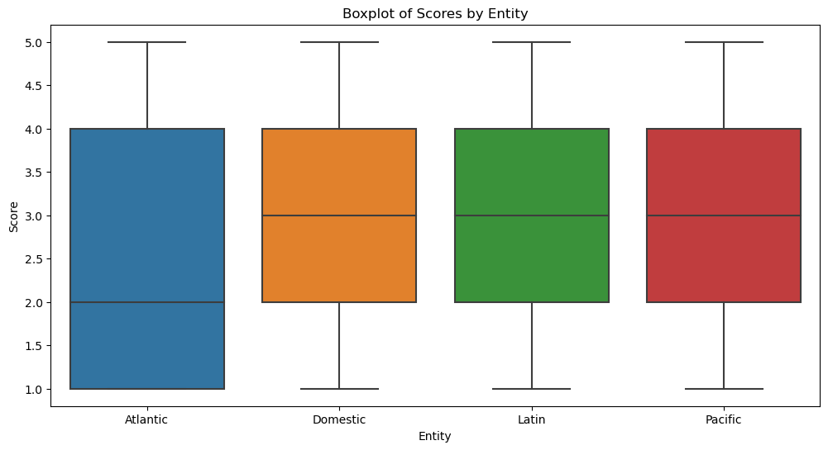
A High IQR (Inter Quartile Range) in F&b Satisfaction Score has been observed in Atlantic Flights.
With a variance towards lower F&B score special focus needs to be laid oon these Atlantic entity flights.

Slide 5
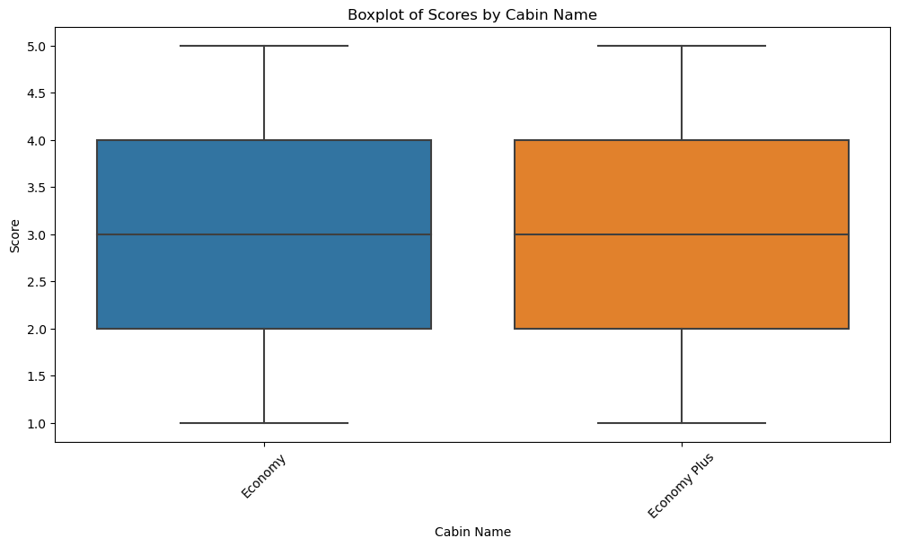
No significant disparity was found amoingst cabin classes

Slide 6
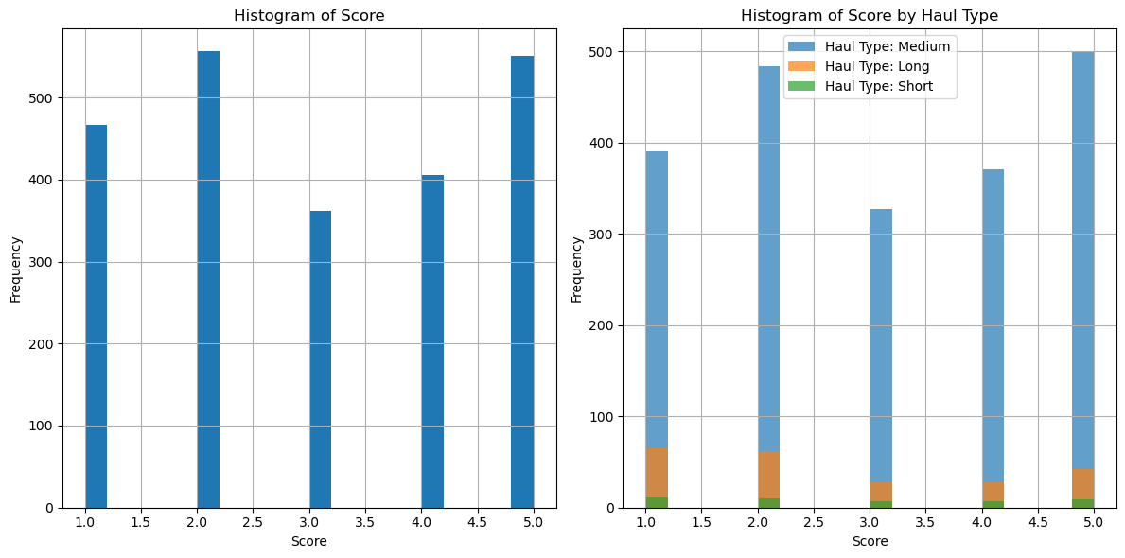

Slide 7
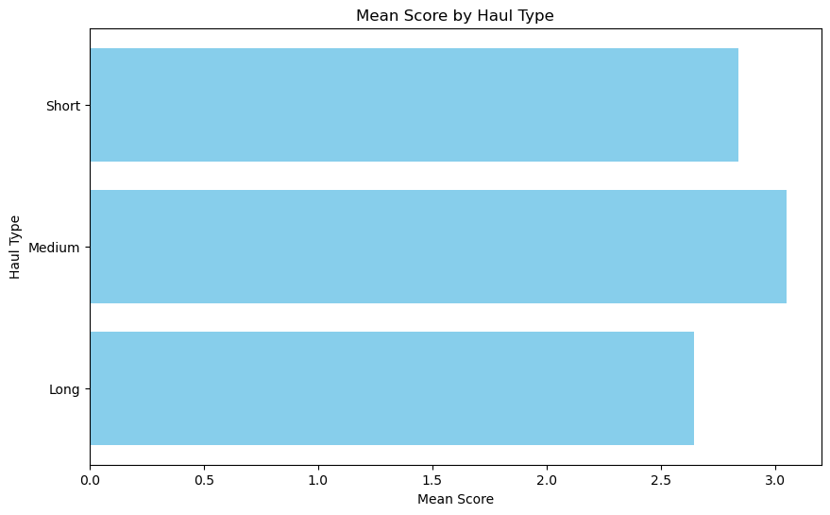
IT HAS BEEN FOUND THAT SATISFACTION SCORE IS SLIGHLY BETTER IN MEDIUM HAUL FLIGHTS AGAINST SHORT HAUL FLIGHTS.
SPECIAL EFFORTS MAY BE MADE TO ADDRESS LONG HAUL FLIGHTS IN ORDER TO IMPROVE OVERALL F&B SATISFACTION SCORE

Slide 8
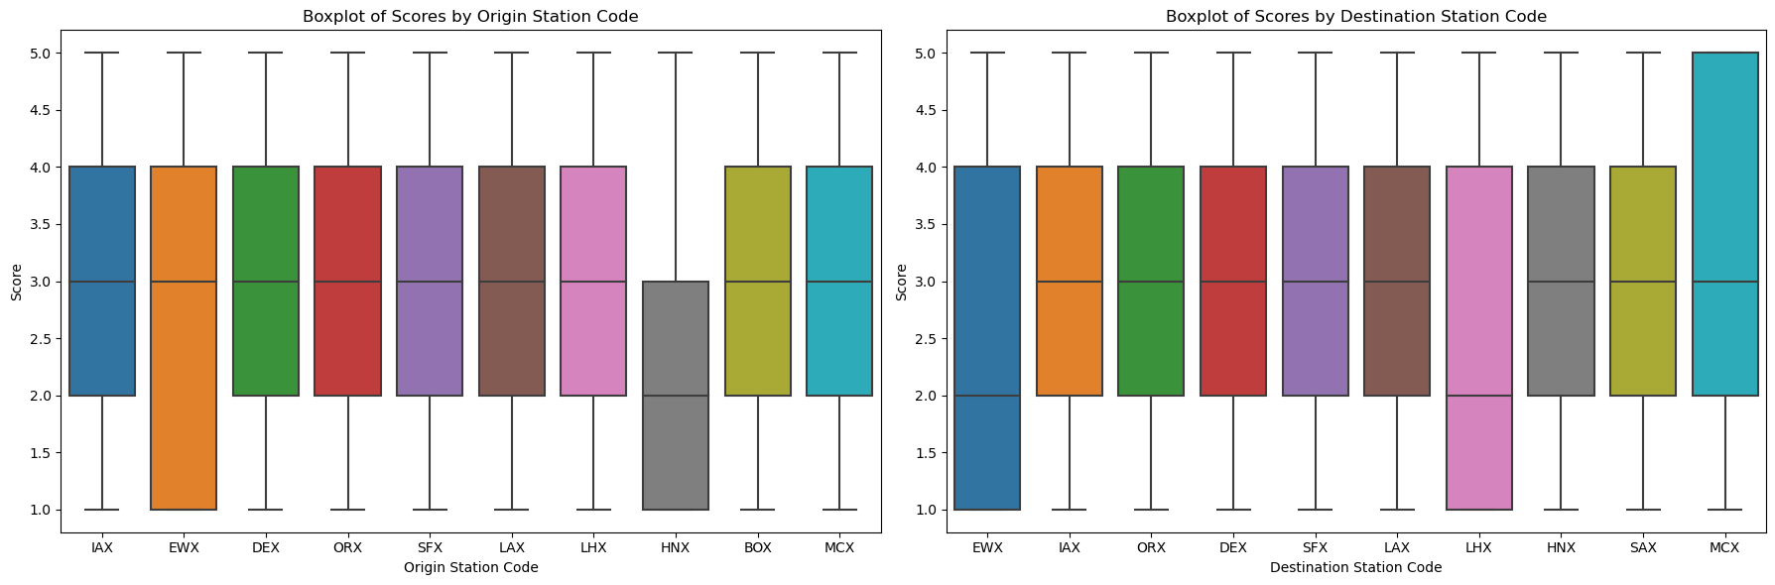
For Origin Station Code
F-Statistic: 17.34
p-Value: 6.28×10−296.28×10−29
For Destination Station Code
F-Statistic: 20.82
p-Value: 2.03×10−352.03×10−35
Confirming impact of certain aiports on F&B Score & passenger's experience
CERTAIN ARRIVAL AND DESTINATION AIRPORTS ARE BADLY IMPACTING PASSENGERS EXPERIENCE MAKING THEM TO HAVE A TENDENCY TO SHOW LOWER F&B RATINGS
ALSO AIRPORT WITH CODE "EWX" MAY BE FLAGGED AS POOR PERFORMER

Slide 9
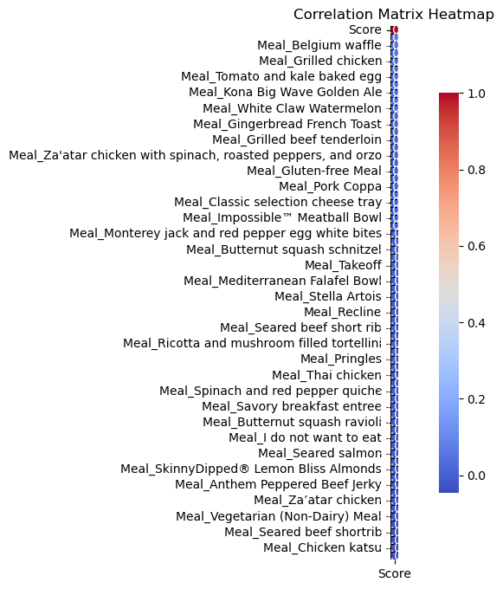
DIFFERENT ITEMS SERVED AFFECT F&B SCORE INVARIABLY
IN THE CORRELATION HEATMAP SHOWN, WE MAY OBSERVE THAT ITEMS ON UPWARD SIDE YIELD BETTER SDATISFACTION THAN ITEMS ON DOWNWARD SIDE

Slide 10
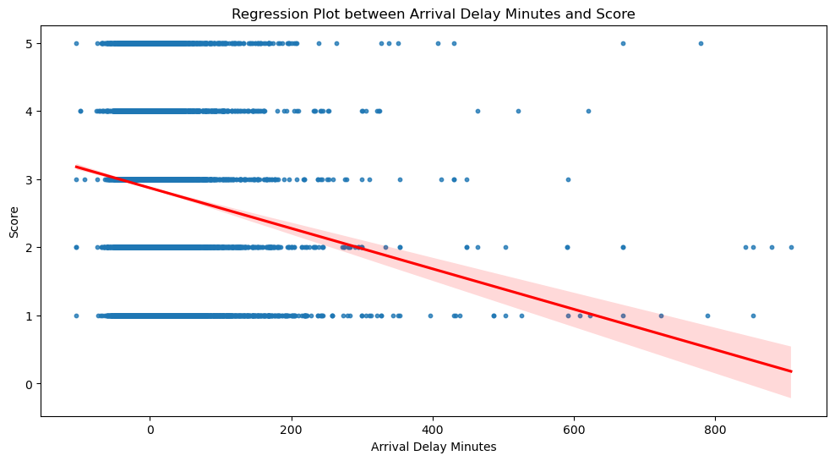
IT MAY BE INFERRED THAT DELAY IN FLIGHT ARRIVALS LEADS TO TENDENCY AMONGST USERS TO DOWNGRADE F&B SATISFACTION RATINGS

Slide 11
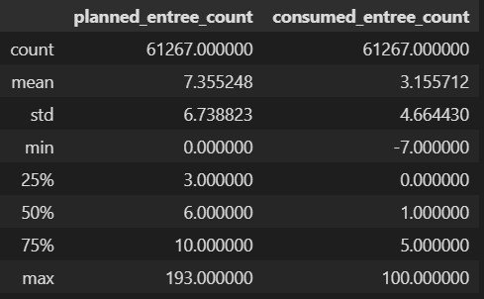
Planned Entree Count:
Mean: 7.367.36
Min: 00
Max: 193
Consumed Entree Count:
Mean: 3.163.16
Min: −7
Max: 100
It appears that the average planned_entree_count is significantly higher than the average consumed_entree_count, suggesting that there might be over-planning in some cases.

Slide 12
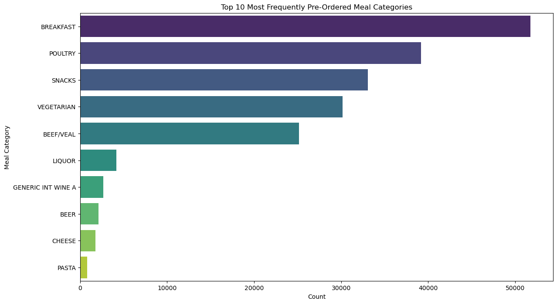
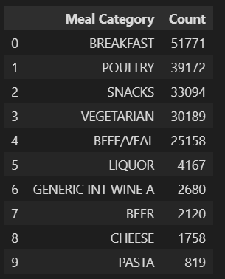
BREAKFAST IS MOST POPULAR/MOST PRE-ORDERED MEAL CATEGORY FOLLOWED BY POULTRY, SNACKS, VEG AND BEEF.

Slide 13
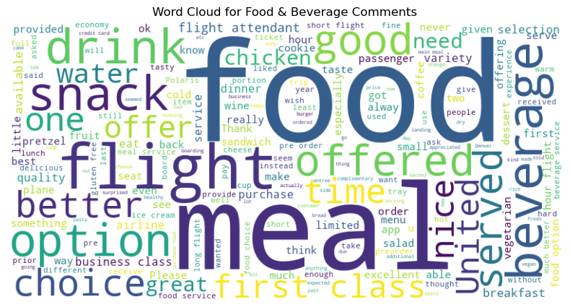
Major Themes that can help in boosting pre-orders:
Meal Options: The frequency of words like "meal," "options," "offered," and "available" suggests that the variety and availability of meals could be a concern for passengers.
Quality: Words like "good" and "better" could be indicative of passengers' expectations around the quality of food.
Pre-Ordering: The term "pre" is likely related to pre-ordering, suggesting that this is a notable topic among passengers.
Service: Words like "served," "class," and "united" may indicate that the level of service could also be a significant factor affecting F&B satisfaction.
food 1585 mentions
flight 999 mentions
meal 849 mentions
good 358 mentions
did 343 mentions
class 333 mentions
beverage 333 mentions
offered 329 mentions
options 322 mentions
snack 296 mentions
better 280 mentions
meals 274 mentions
served 272 mentions
service 256 mentions
drink 252 mentions
like 249 mentions
beverages 224 mentions
snacks 221 mentions
just 218 mentions
time 212 mentions
The suggestion is drawn by performing sentiment analysis with help of NLP Technique "word vectorization"Post applying it on a customer feedback data.

Slide 14
Here are some sample customer comments related to Food & Beverage services:
"They serve the drinks half of the glass and no snacks."
"oh!. I was answering for my flight from Houston where they didn't even offer a beverage."
"Please please get smarter on allergies - more labeling on food."
"Not offered water, drink or anything before takeoff."
"There was no choice for the complementary snack."
From these comments, we can identify several areas that might affect F&B satisfaction:
Portion Size: Customers may have concerns about the size of the drink servings.
Service: The lack of beverage service on some flights appears to be an issue.
Allergies: Customers desire more labeling on food to identify potential allergens.
Options: Limited options or no choice in snacks can also negatively impact customer satisfaction.

Slide 15
Conclusions:
F&B rating may not solely be based on F&B quality but may also get affected by external conditions like airport as observed. Airport with code "EWH" may be checked as it presumably effecting passenger experience and badly impacting F&B satisfaction statistics.
"Atlanta" entity flights are performing poor in terms of passenger experience as reflected in its poorer F&B ratings.
Flight arrival delays, especially post a threshold of 40 minutes reflect a bad impact on F&B ratings.
Certain food & beverage items are more popular and also provide better average F&B satisfaction than some other meal items as observed on correlation heatmap. Breakfast is most popular meal category.
There is overplanning in inventory management with high mean entree count difference of ~4.2, thereby leading to unnecessary costs and wastages.
It may be observed that medium haul flights are yielding highest F&B score on an average.

Slide 16
Some possible improvements to deep dive:
Time Series Analysis:
Time Series Analysis:
The goal is to identify any temporal treTime Series Analysis:
nds or seasonality in customer satisfaction with F&B services.
Dataset needs to be re-prepared into temporal-timestamp based data to find any seasonal trend. An attempt has been made for the same kept is seperate time_series.py file.
Customer segmentation:
The aim is to group customers based on similar characteristics or behaviors.
Appropriate Feature based labelling, feature selection, clustering algorithms like k-means and profile summarizing of customer may be needed.
An attempt for the same has been made in customer_segmentation.ipynb file.

